Slide 1
Инициализация сетевого оборудования
Петухов Андрей
petand@lvk.cs.msu.su
Антоненко Виталий
anvial@lvk.cs.msu.su
комната 247

Slide 2
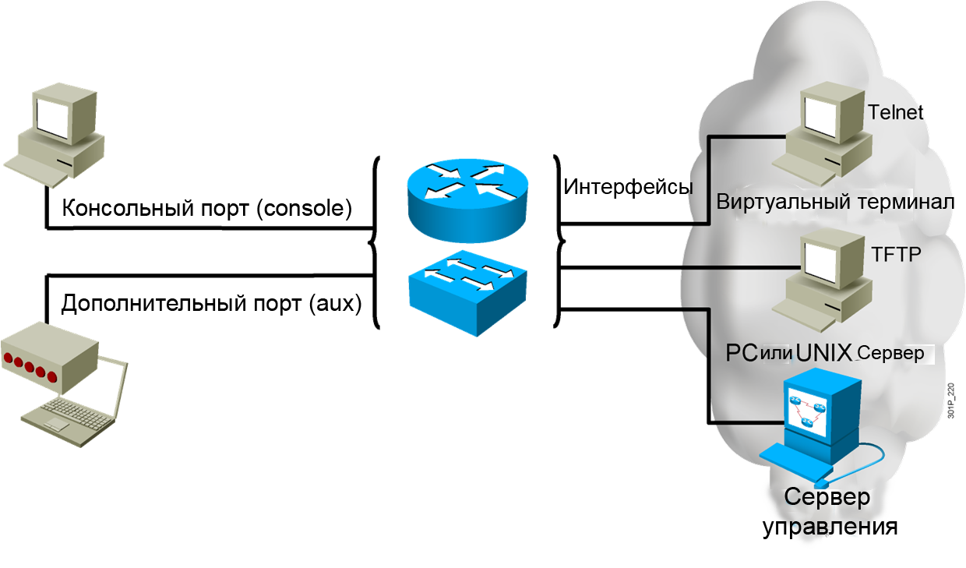
Управляющее воздействие

Slide 3
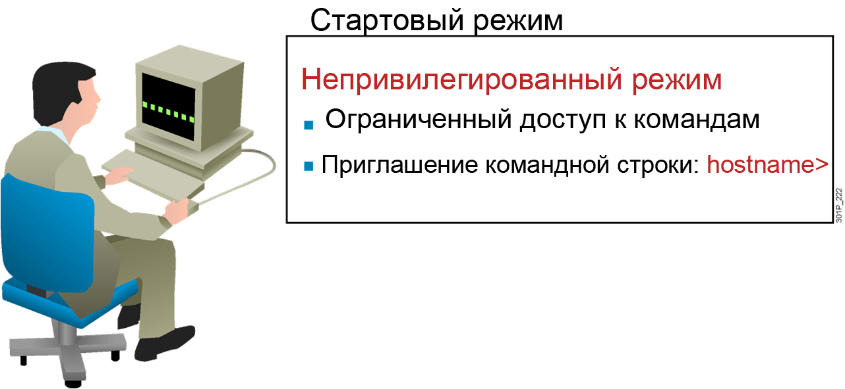
Обычный режим

Slide 4
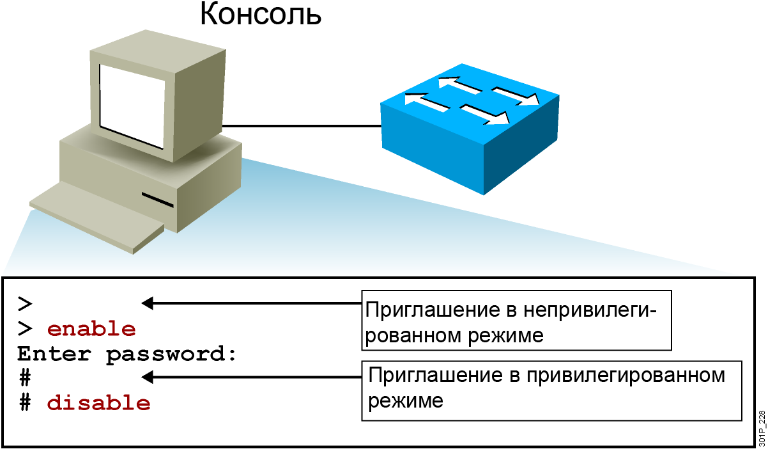
Привилегированный режим

Slide 5
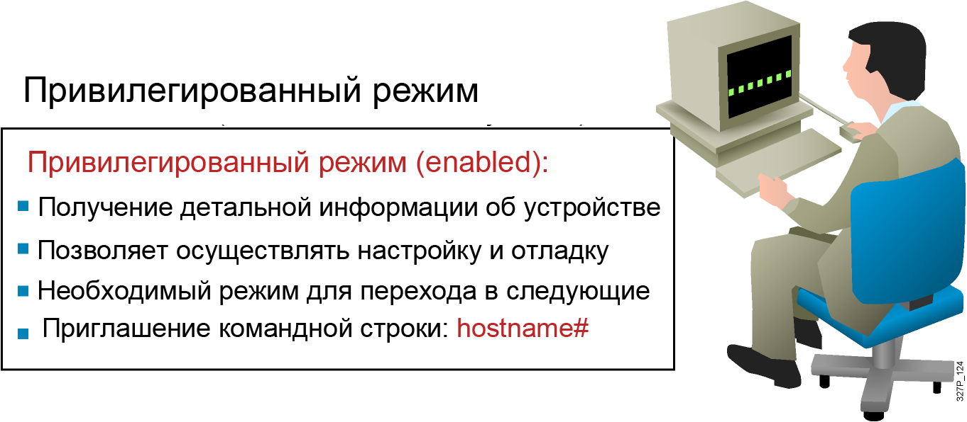
Привилегированный режим

Slide 6
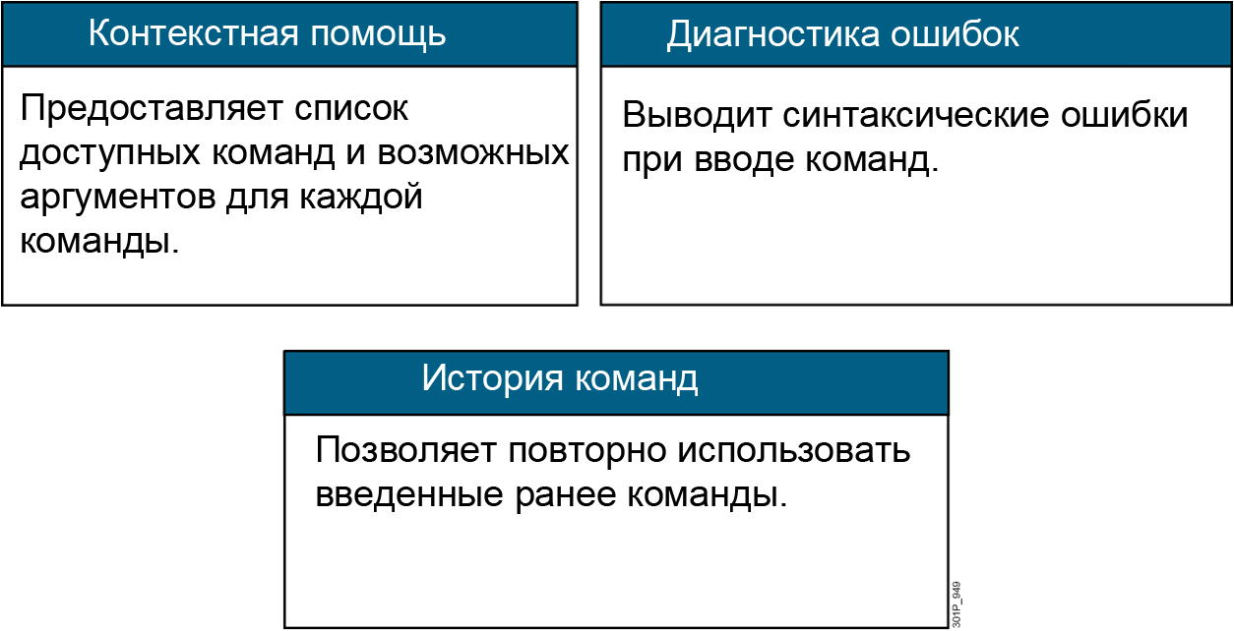
Инструменты командной строки

Slide 7
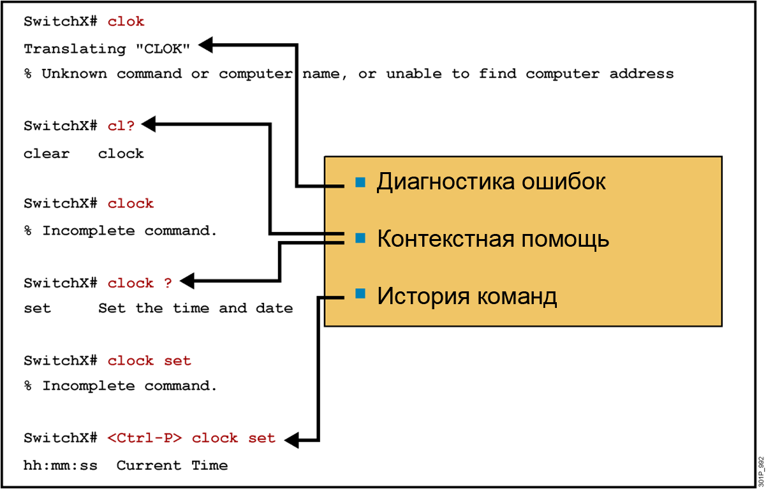
Контекстная помощь

Slide 8
Просмотр списка доступных команд
RouterX>?
Exec commands:
access-enable Create a temporary Access-List entry
access-profile Apply user-profile to interface
clear Reset functions
connect Open a terminal connection
disable Turn off privileged commands
disconnect Disconnect an existing network connection
enable Turn on privileged commands
exit Exit from the EXEC
help Description of the interactive help system
lat Open a lat connection
lock Lock the terminal
login Log in as a particular user
logout Exit from the EXEC
-- More --

Slide 9
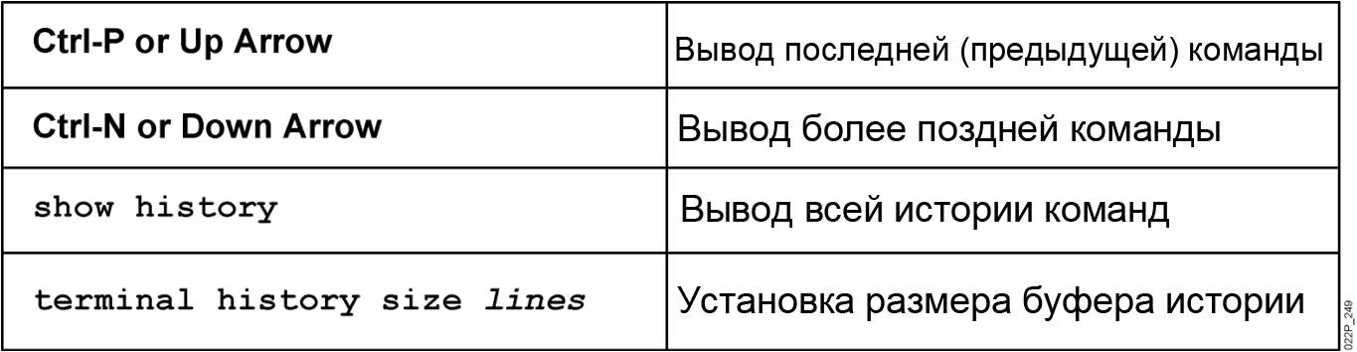
История команд

Slide 10

Режимы конфигурации коммутатора
Режимы конфигурации:
  Режим глобальной конфигурации
    SwitchX#configure terminal
    SwitchX(config)#
  Режим конфигурации интерфейса
    SwitchX(config)#interface fa0/1
    SwitchX(config-if)#

Slide 11
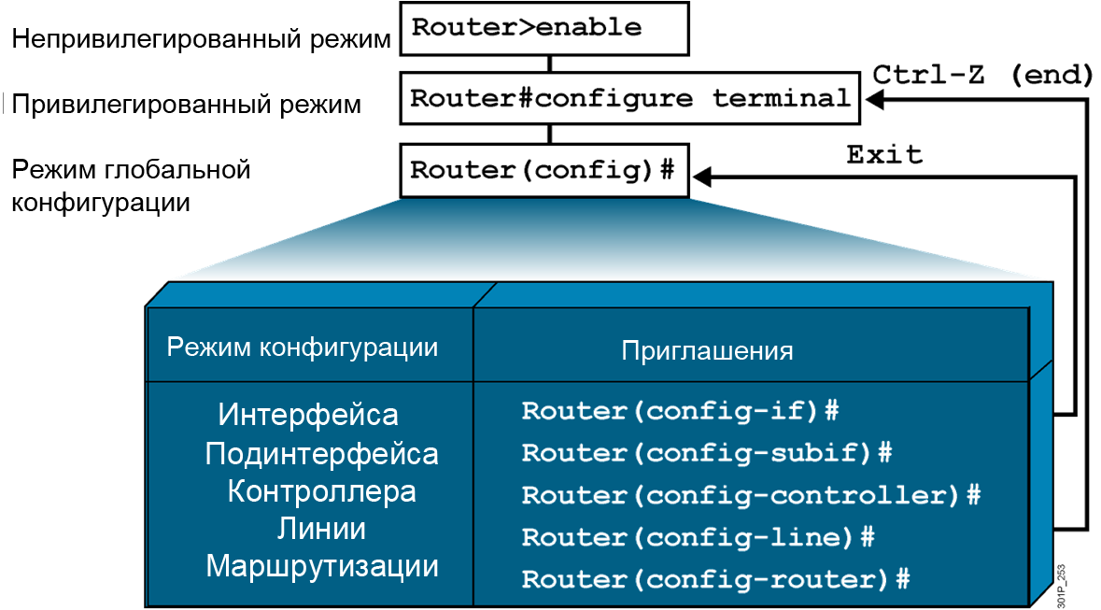
Режимы конфигурации маршрутизатора

Slide 12
Общая настройка сетевого устройства
DeviceX(config)#hostname DeviceX
DeviceX(config)#enable password cisco
DeviceX(config)#enable secret san-fran
DeviceX(config)#service password-encryption
DeviceX(config)#banner motd # Authorized
access
only! #

Slide 13
Конфигурирование консольного соединения на сетевом устройстве
DeviceX(config)#line console 0
DeviceX(config-line)#exec-timeout 20 30
DeviceX(config)#line console 0
DeviceX(config-line)#logging synchronous
DeviceX(config)#line console 0
DeviceX(config-line)#password cisco
DeviceX(config-line)#login

Slide 14
Конфигурирование терминального соединения на сетевом устройстве
DeviceX(config)#line vty 0 4
DeviceX(config-line)#exec-timeout 20 30
DeviceX(config)#line vty 0 4
DeviceX(config-line)#logging synchronous
DeviceX(config)#line vty 0 4
DeviceX(config-line)#password cisco
DeviceX(config-line)#login

Slide 15
Настройка интерфейса
RouterX(config)#interface type number
RouterX(config-if)#
RouterX(config)#interface type slot/port
RouterX(config-if)#
RouterX(config-if)# description string
RouterX(config-if)# clock rate number
RouterX(config-if)#exit

Slide 16
Настройка IP адреса коммутатора
SwitchX(config)#interface vlan 1
SwitchX(config-if)#ip address {ip address} {mask}
Пример:
SwitchX(config)#interface vlan 1
SwitchX(config-if)#ip address 10.5.5.11 255.255.255.0
SwitchX(config-if)#no shutdown
SwitchX(config)#ip host Router-X-1 10.1.1.1

Slide 17
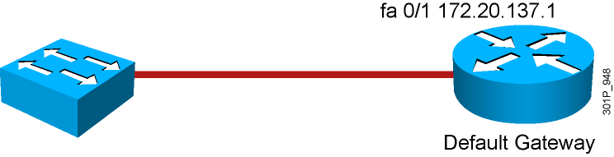
Настройка шлюза по умолчанию у коммутатора
SwitchX(config)#ip default-gateway {ip address}
Пример:
SwitchX(config)#ip default-gateway 172.20.137.1

Slide 18
Настройка IP адреса маршрутизатора
RouterX(config)#interface ethernet 0
RouterX(config-if)#ip address {ip address} {mask}
Пример:
RouterX(config)#interface ethernet 0
RouterX(config-if)#ip address 10.5.5.11 255.255.255.0
RouterX(config-if)#no shutdown
RouterX(config)#ip host Switch-X-1 10.1.1.100

Slide 19
Включение и отключение интерфейса
RouterX#configure terminal
RouterX(config)#interface serial 0
RouterX(config-if)#shutdown
%LINK-5-CHANGED: Interface Serial0, changed state to administratively down
%LINEPROTO-5-UPDOWN: Line protocol on Interface Serial0, changed state to down
RouterX#configure terminal
RouterX(config)#interface serial 0
RouterX(config-if)#no shutdown
%LINK-3-UPDOWN: Interface Serial0, changed state to up
%LINEPROTO-5-UPDOWN: Line Protocol on Interface Serial0, changed state to up

Slide 20
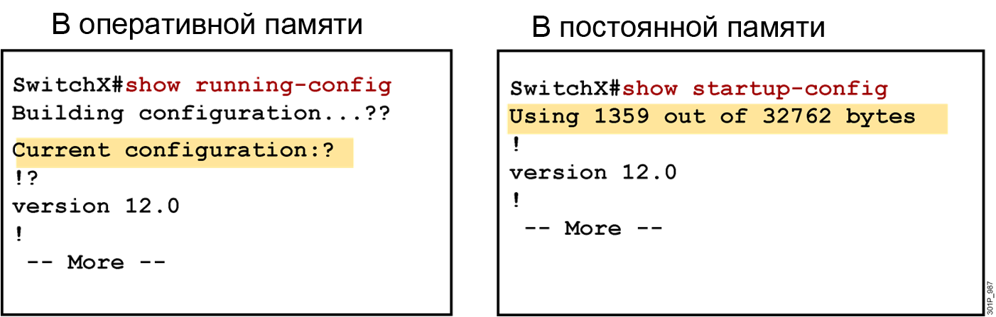
Текущая и начальная конфигурация

Slide 21
Сохранение конфигурации
SwitchX
SwitchX copy running-config startup-config
Destination filename [startup-config]?
Building configuration…
SwitchX

Slide 22
Вывод информации о сетевом устройстве
DeviceX#show version
DeviceX#show running-config
DeviceX#show interfaces

Slide 23
Команда show version на коммутаторе
Switch#show version
SOFTWARE (fc1)
Copyright (c) 1986-2006 by Cisco Systems, Inc.
Compiled Fri 28-Jul-06 11:57 by yenanh
Image text-base: 0x00003000, data-base: 0x00BB7944
ROM: Bootstrap program is C2960 boot loader
BOOTLDR: C2960 Boot Loader (C2960-HBOOT-M) Version 12.2(25r)SEE1, RELEASE SOFTWARE (fc1)
System returned to ROM by power-on
System image file is "flash:c2960-lanbasek9-mz.122-25.SEE2/c2960-lanbasek9-mz.122-25.SEE2.bin"
Processor board ID FOC1052W3XC
Last reset from power-on
1 Virtual Ethernet interface
24 FastEthernet interfaces
2 Gigabit Ethernet interfaces
The password-recovery mechanism is enabled.
! Text omitted
Switch#
Cisco IOS Software, C2960 Software (C2960-LANBASEK9-M), Version 12.2(25)SEE2, RELEASE
Switch uptime is 24 minutes
cisco WS-C2960-24TT-L (PowerPC405) processor (revision B0) with 61440K/4088K bytes of memory.

Slide 24
Команда show interfaces на коммутаторе
SwitchX#show interfaces FastEthernet0/2
FastEthernet0/2 is up, line protocol is up (connected)
Hardware is Fast Ethernet, address is 0008.a445.ce82 (bia 0008.a445.ce82)
MTU 1500 bytes, BW 10000 Kbit, DLY 1000 usec,
reliability 255/255, txload 1/255, rxload 1/255
Encapsulation ARPA, loopback not set
Keepalive set (10 sec)
Half-duplex, 10Mb/s
input flow-control is unsupported output flow-control is unsupported
ARP type: ARPA, ARP Timeout 04:00:00
Last input 4w6d, output 00:00:01, output hang never
Last clearing of "show interface" counters never
Input queue: 0/75/0/0 (size/max/drops/flushes); Total output drops: 0
Queueing strategy: fifo
Output queue: 0/40 (size/max)
5 minute input rate 0 bits/sec, 0 packets/sec
5 minute output rate 0 bits/sec, 0 packets/sec
182979 packets input, 16802150 bytes, 0 no buffer
Received 49954 broadcasts (0 multicast)
0 runts, 0 giants, 0 throttles
0 input errors, 0 CRC, 0 frame, 0 overrun, 8 ignored
0 watchdog, 20115 multicast, 0 pause input
0 input packets with dribble condition detected
3747473 packets output, 353656347 bytes, 0 underruns
--More--

Slide 25
Команда show interfaces на маршрутизаторе
RouterX#show interfaces
Ethernet0 is up, line protocol is up
Hardware is Lance, address is 00e0.1e5d.ae2f (bia 00e0.1e5d.ae2f)
Internet address is 10.1.1.11/24
MTU 1500 bytes, BW 10000 Kbit, DLY 1000 usec, rely 255/255, load 1/255
Encapsulation ARPA, loopback not set, keepalive set (10 sec)
ARP type: ARPA, ARP Timeout 04:00:00
Last input 00:00:07, output 00:00:08, output hang never
Last clearing of "show interface" counters never
Queueing strategy: fifo
Output queue 0/40, 0 drops; input queue 0/75, 0 drops
5 minute input rate 0 bits/sec, 0 packets/sec
5 minute output rate 0 bits/sec, 0 packets/sec
81833 packets input, 27556491 bytes, 0 no buffer
Received 42308 broadcasts, 0 runts, 0 giants, 0 throttles
1 input errors, 0 CRC, 0 frame, 0 overrun, 1 ignored, 0 abort
0 input packets with dribble condition detected
55794 packets output, 3929696 bytes, 0 underruns
0 output errors, 0 collisions, 1 interface resets
0 babbles, 0 late collision, 4 deferred
0 lost carrier, 0 no carrier
0 output buffer failures, 0 output buffers swapped out

Slide 26
Команда show controllers на маршрутизаторе
RouterX#show controllers serial 0
HD unit 0, idb = 0xCF958, driver structure at 0xD4DC8
buffer size 1524 HD unit 0, V.35 DCE cable
cpb = 0x21, eda = 0x4940, cda = 0x4800
RX ring with 16 entries at 0x214800
00 bd_ptr=0x4800 pak=0x0D7E04 ds=0x21ECC8 status=00 pak_size=0
01 bd_ptr=0x4814 pak=0x0D7C04 ds=0x21E60C status=00 pak_size=0
02 bd_ptr=0x4828 pak=0x0D7A04 ds=0x21DF50 status=00 pak_size=0
03 bd_ptr=0x483C pak=0x0D7804 ds=0x21D894 status=00 pak_size=0
04 bd_ptr=0x4850 pak=0x0D7604 ds=0x21D1D8 status=00 pak_size=0
05 bd_ptr=0x4864 pak=0x0D7404 ds=0x21CB1C status=00 pak_size=0
06 bd_ptr=0x4878 pak=0x0D7204 ds=0x21C460 status=00 pak_size=0
07 bd_ptr=0x488C pak=0x0D7004 ds=0x21BDA4 status=00 pak_size=0
08 bd_ptr=0x48A0 pak=0x0D6E04 ds=0x21B6E8 status=00 pak_size=0
09 bd_ptr=0x48B4 pak=0x0D6C04 ds=0x21B02C status=00 pak_size=0
10 bd_ptr=0x48C8 pak=0x0D6A04 ds=0x21A970 status=00 pak_size=0

Slide 27
Команда show cdp neighbors на сетевых устройствах
SwitchX#show cdp neighbors
Switch>sh cdp nei
Capability Codes: R - Router, T - Trans Bridge, B - Source Route Bridge
S - Switch, H - Host, I - IGMP, r - Repeater, P - Phone
Device ID Local Intrfce Holdtme Capability Platform Port ID
Router Fas 0/5 163 R 2500 Eth 1
Router Fas 0/3 156 R 2500 Eth 0
Router Fas 0/2 160 R 2511 Eth 0
Router Fas 0/1 153 R 2500 Eth 0

Slide 28
Вопросы?

